Slide 1
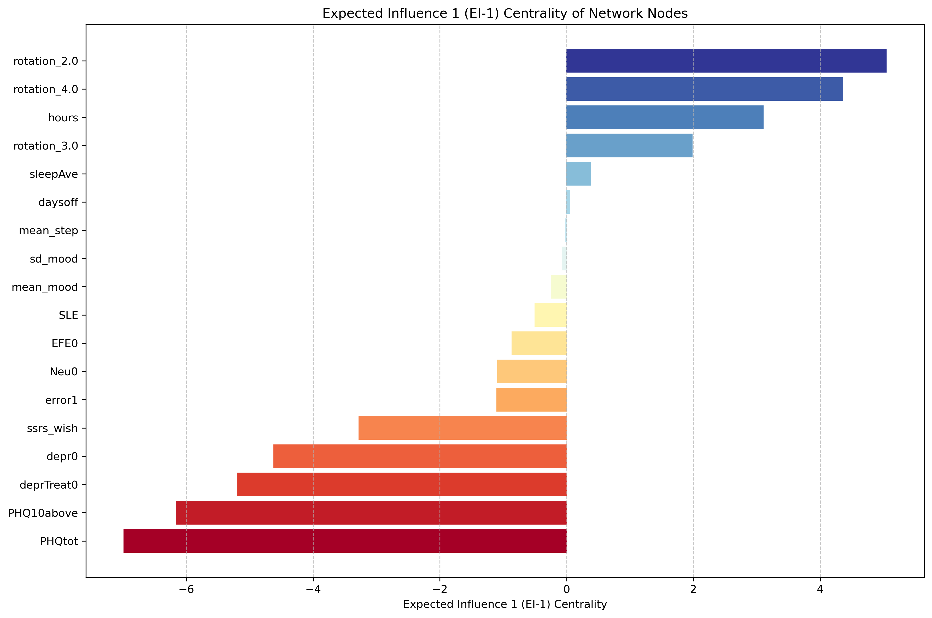

Expected Influence 1 (EI-1) Centrality of Network Nodes
(a) Self-reported sleep duration (hours)
(b) Sensor-based sleep duration (hours)

Slide 2
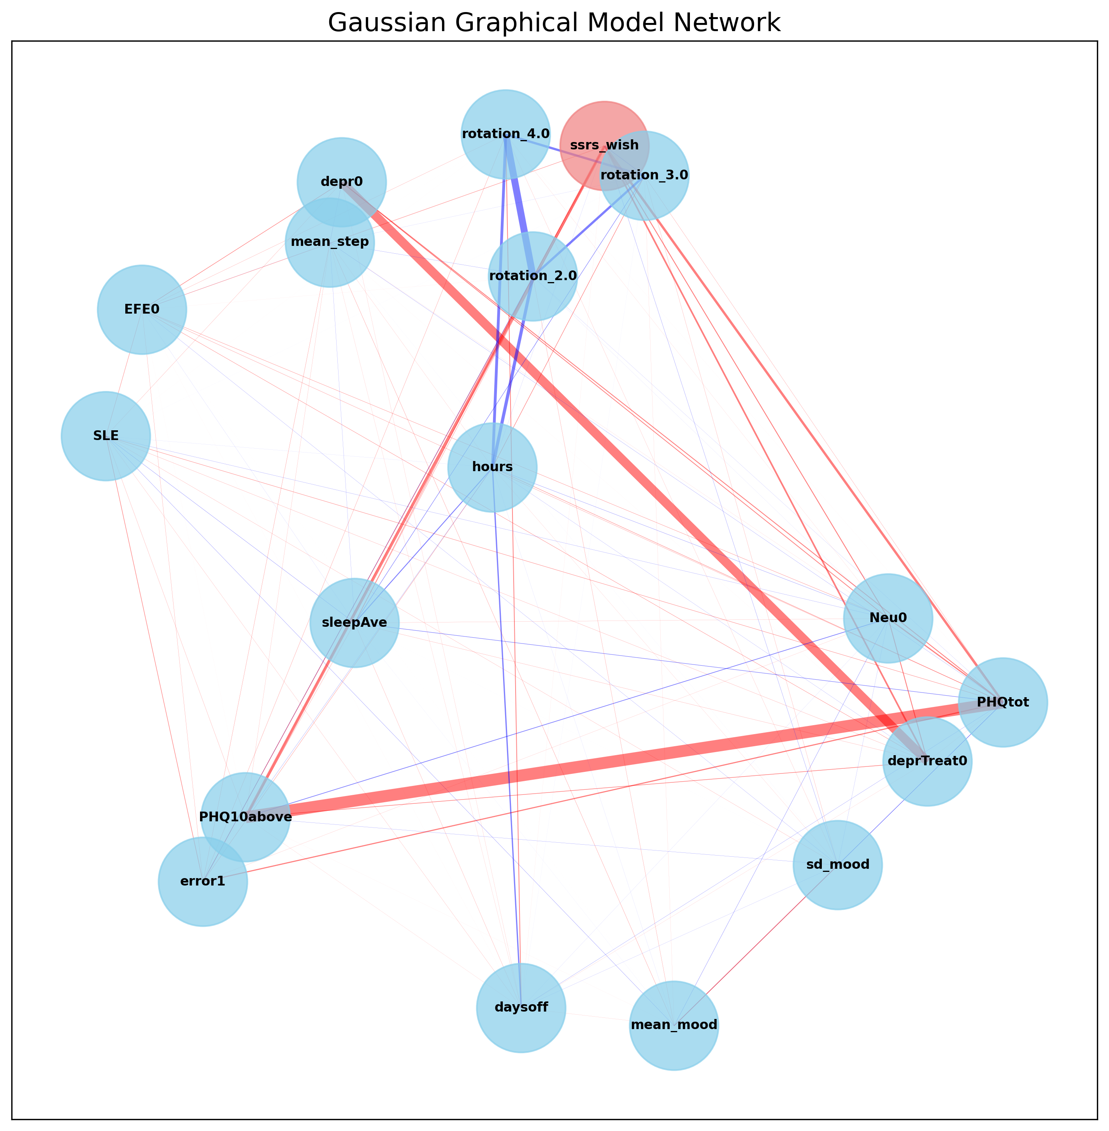
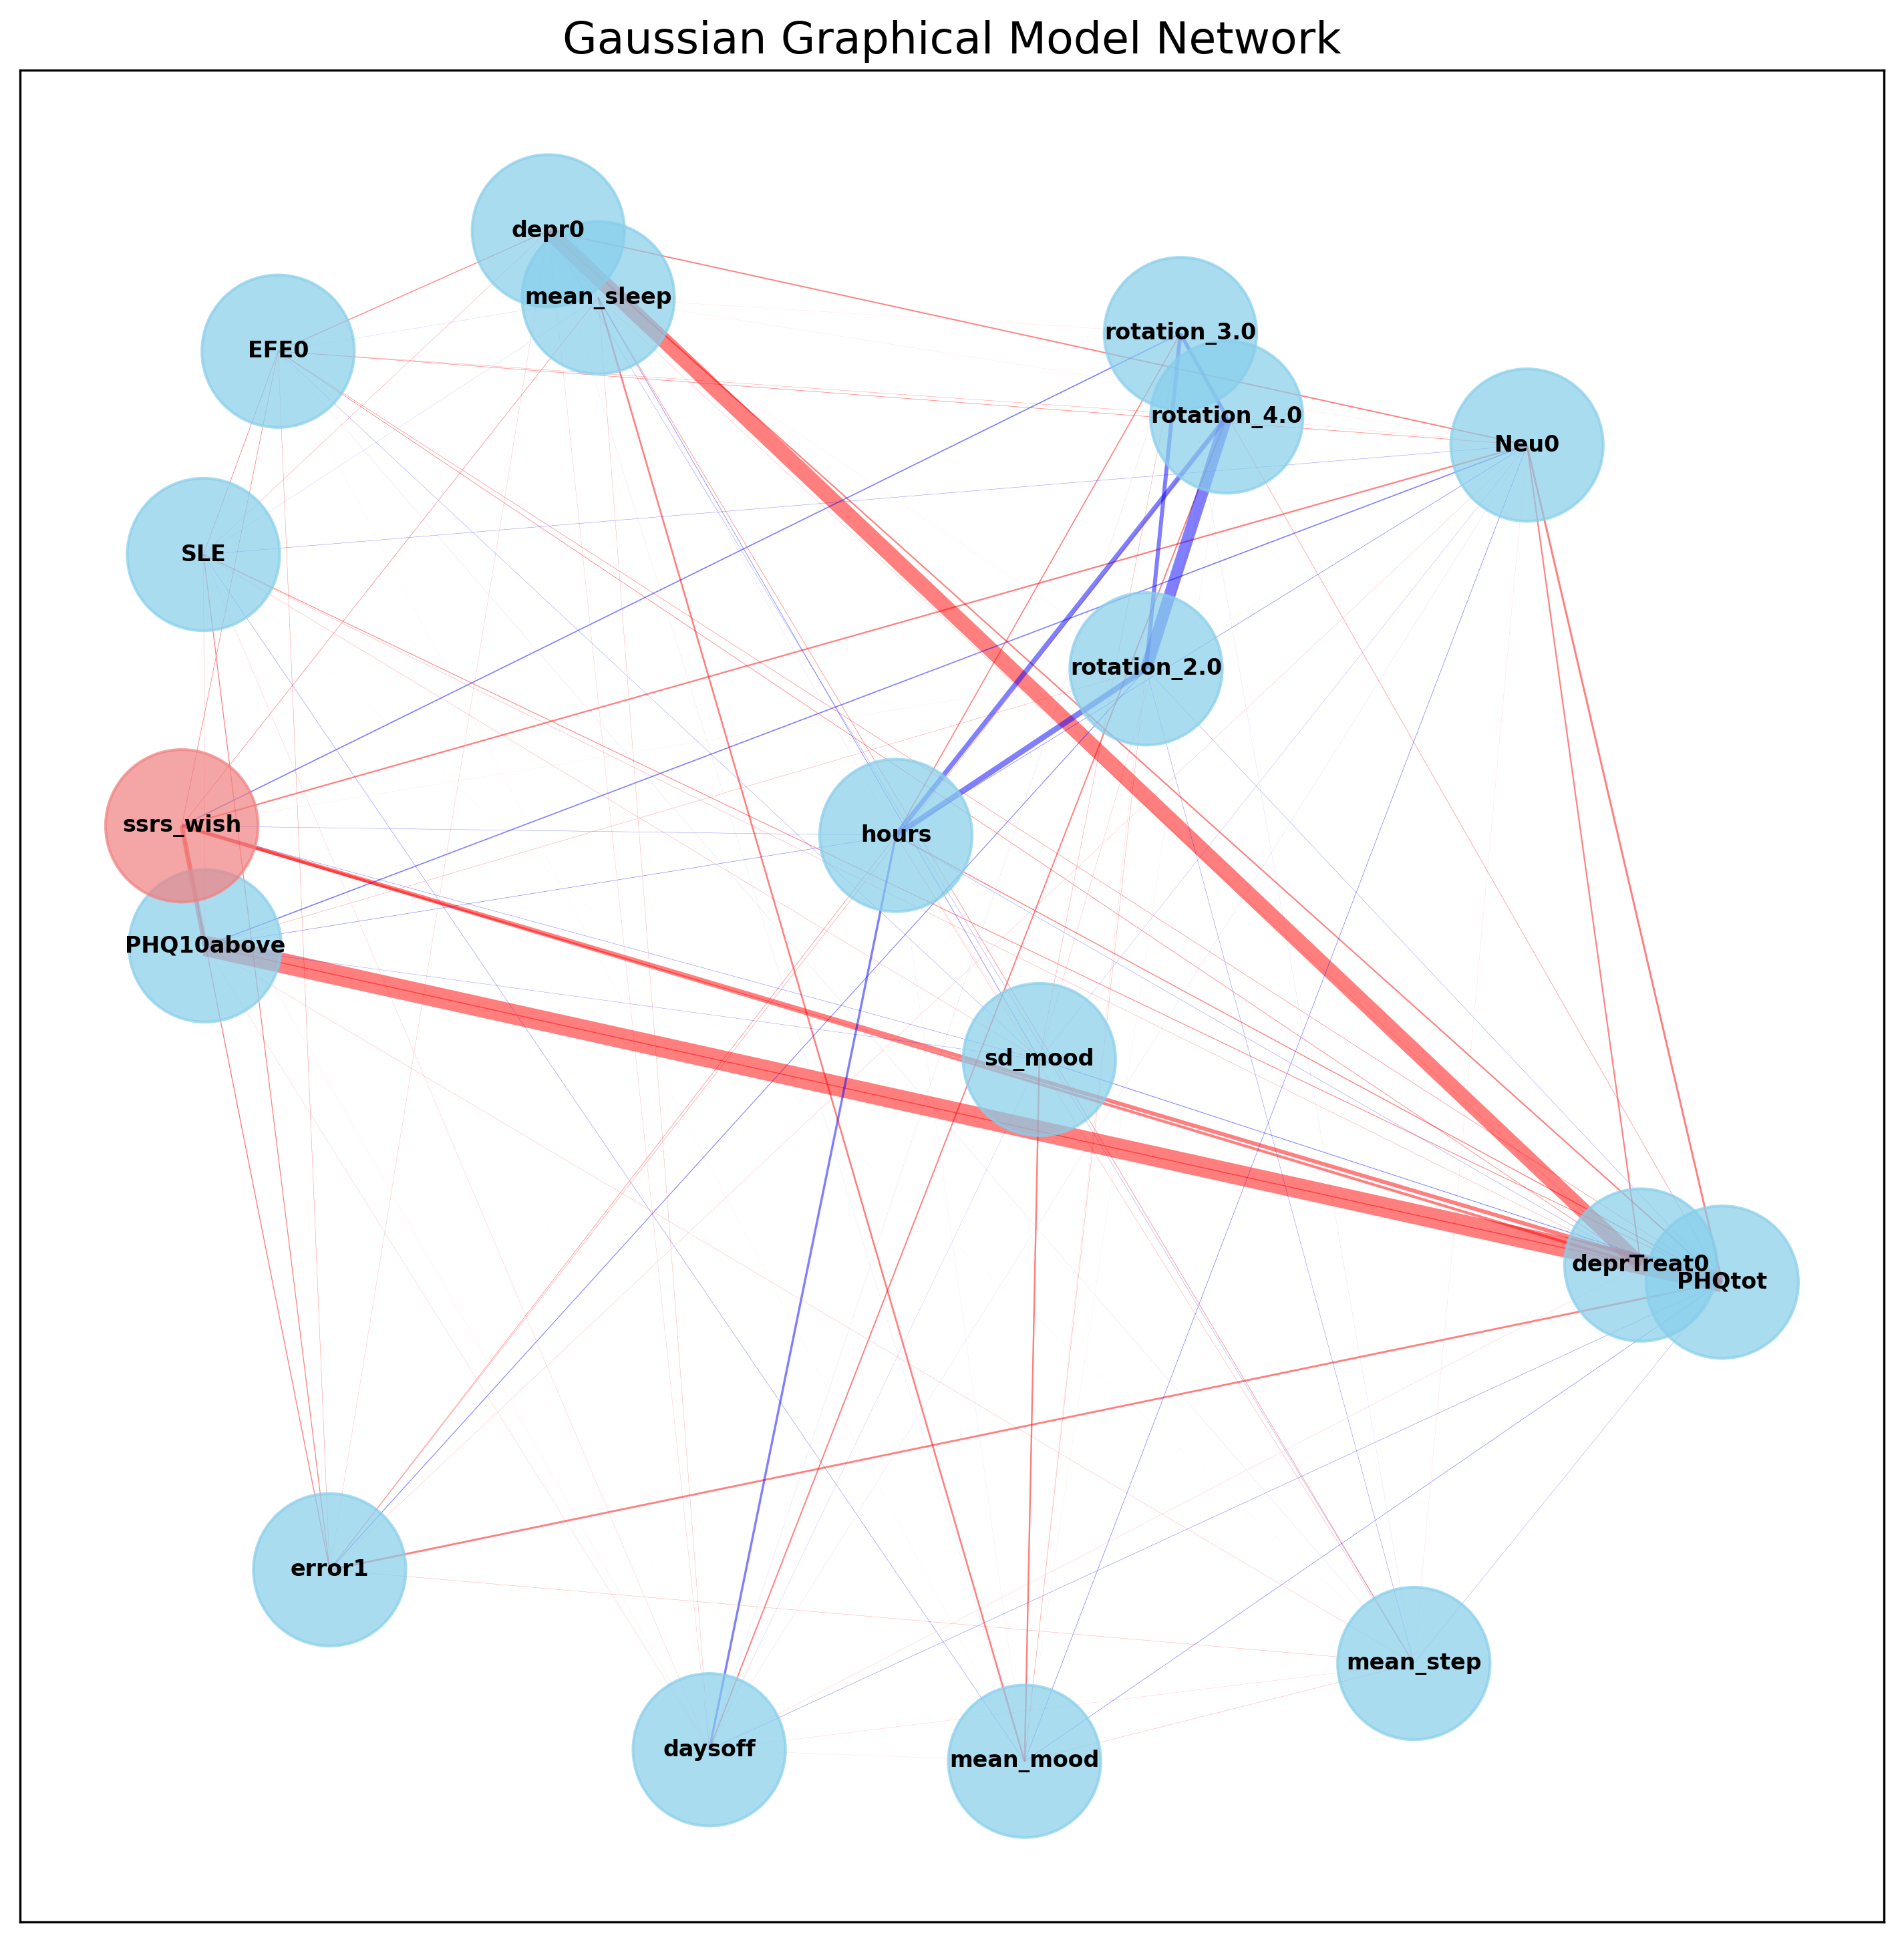
Partial Correlation Networks before Applying Graphical LASSO Regularization
(a) Self-reported sleep duration (hours)
(b) Sensor-based sleep duration (hours)

Slide 3
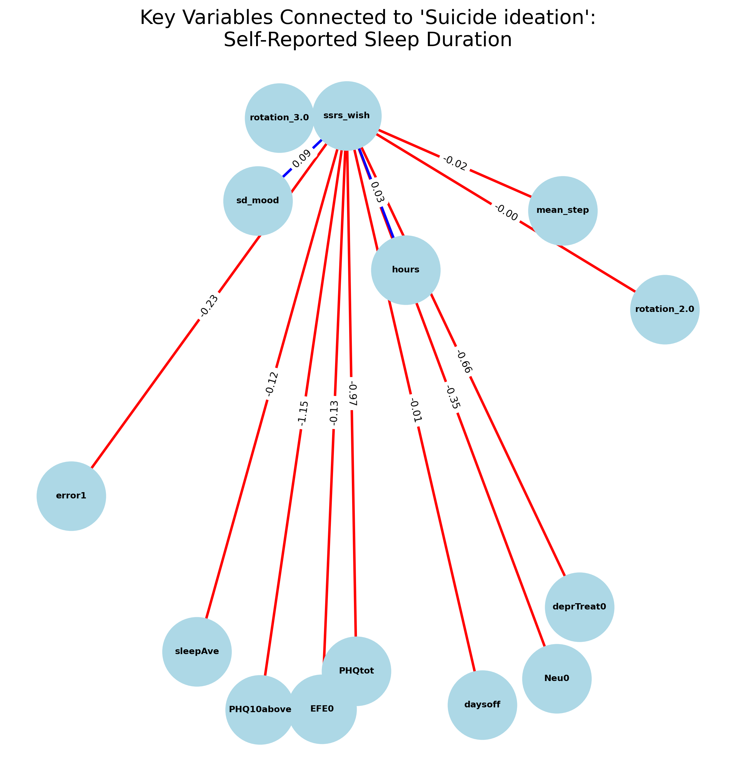
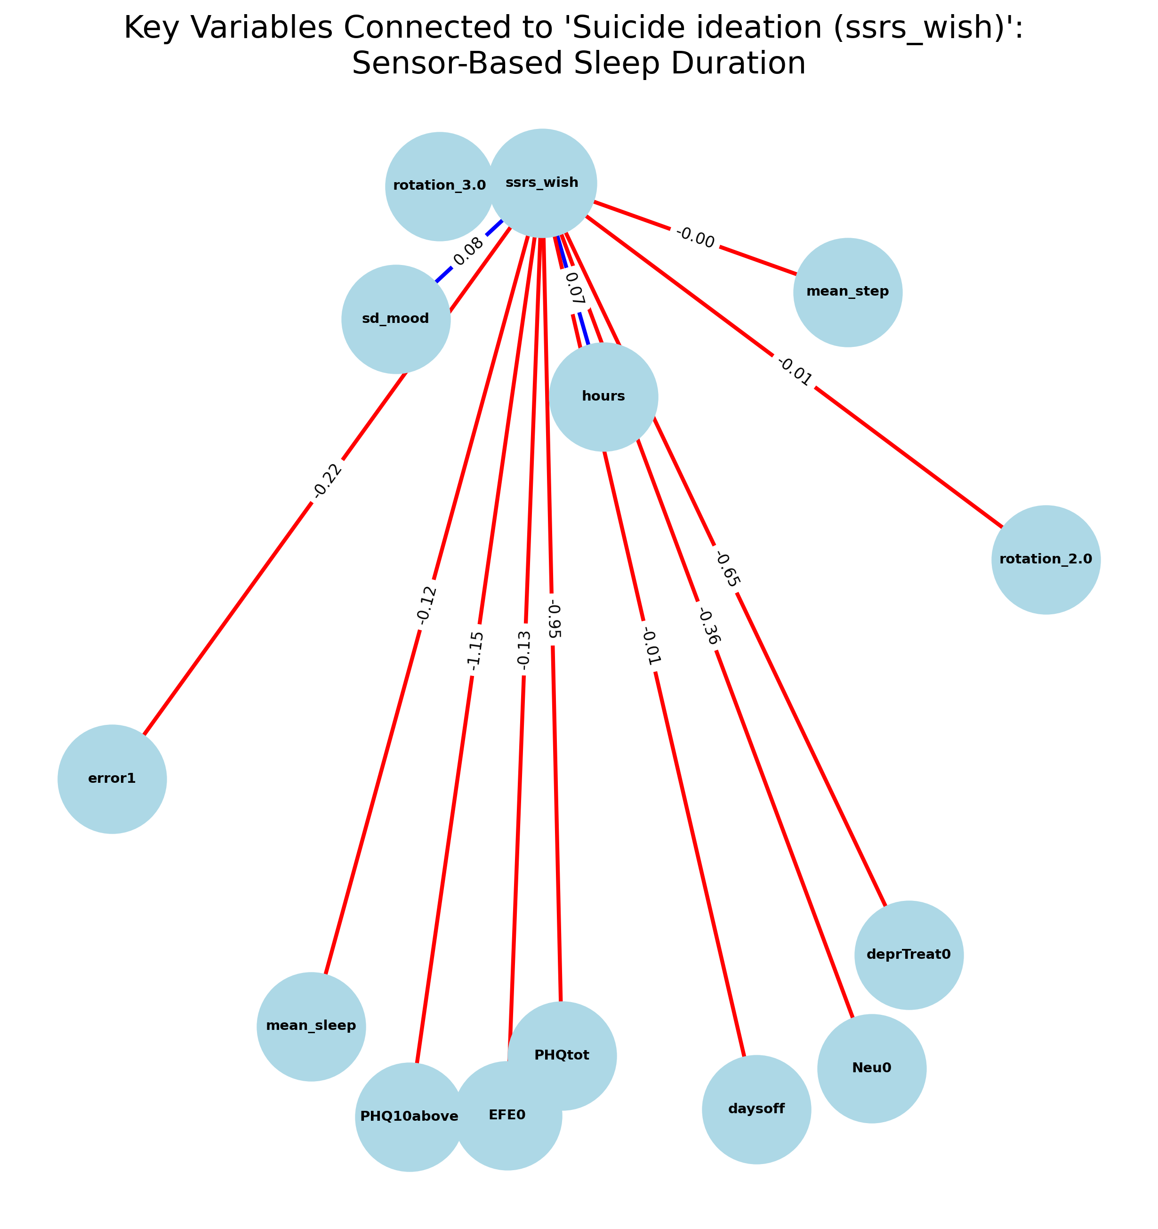
Regularized Partial Correlation Networks
Self-reported sleep duration (hours)
(b) Sensor-based sleep duration (hours)

Slide 4
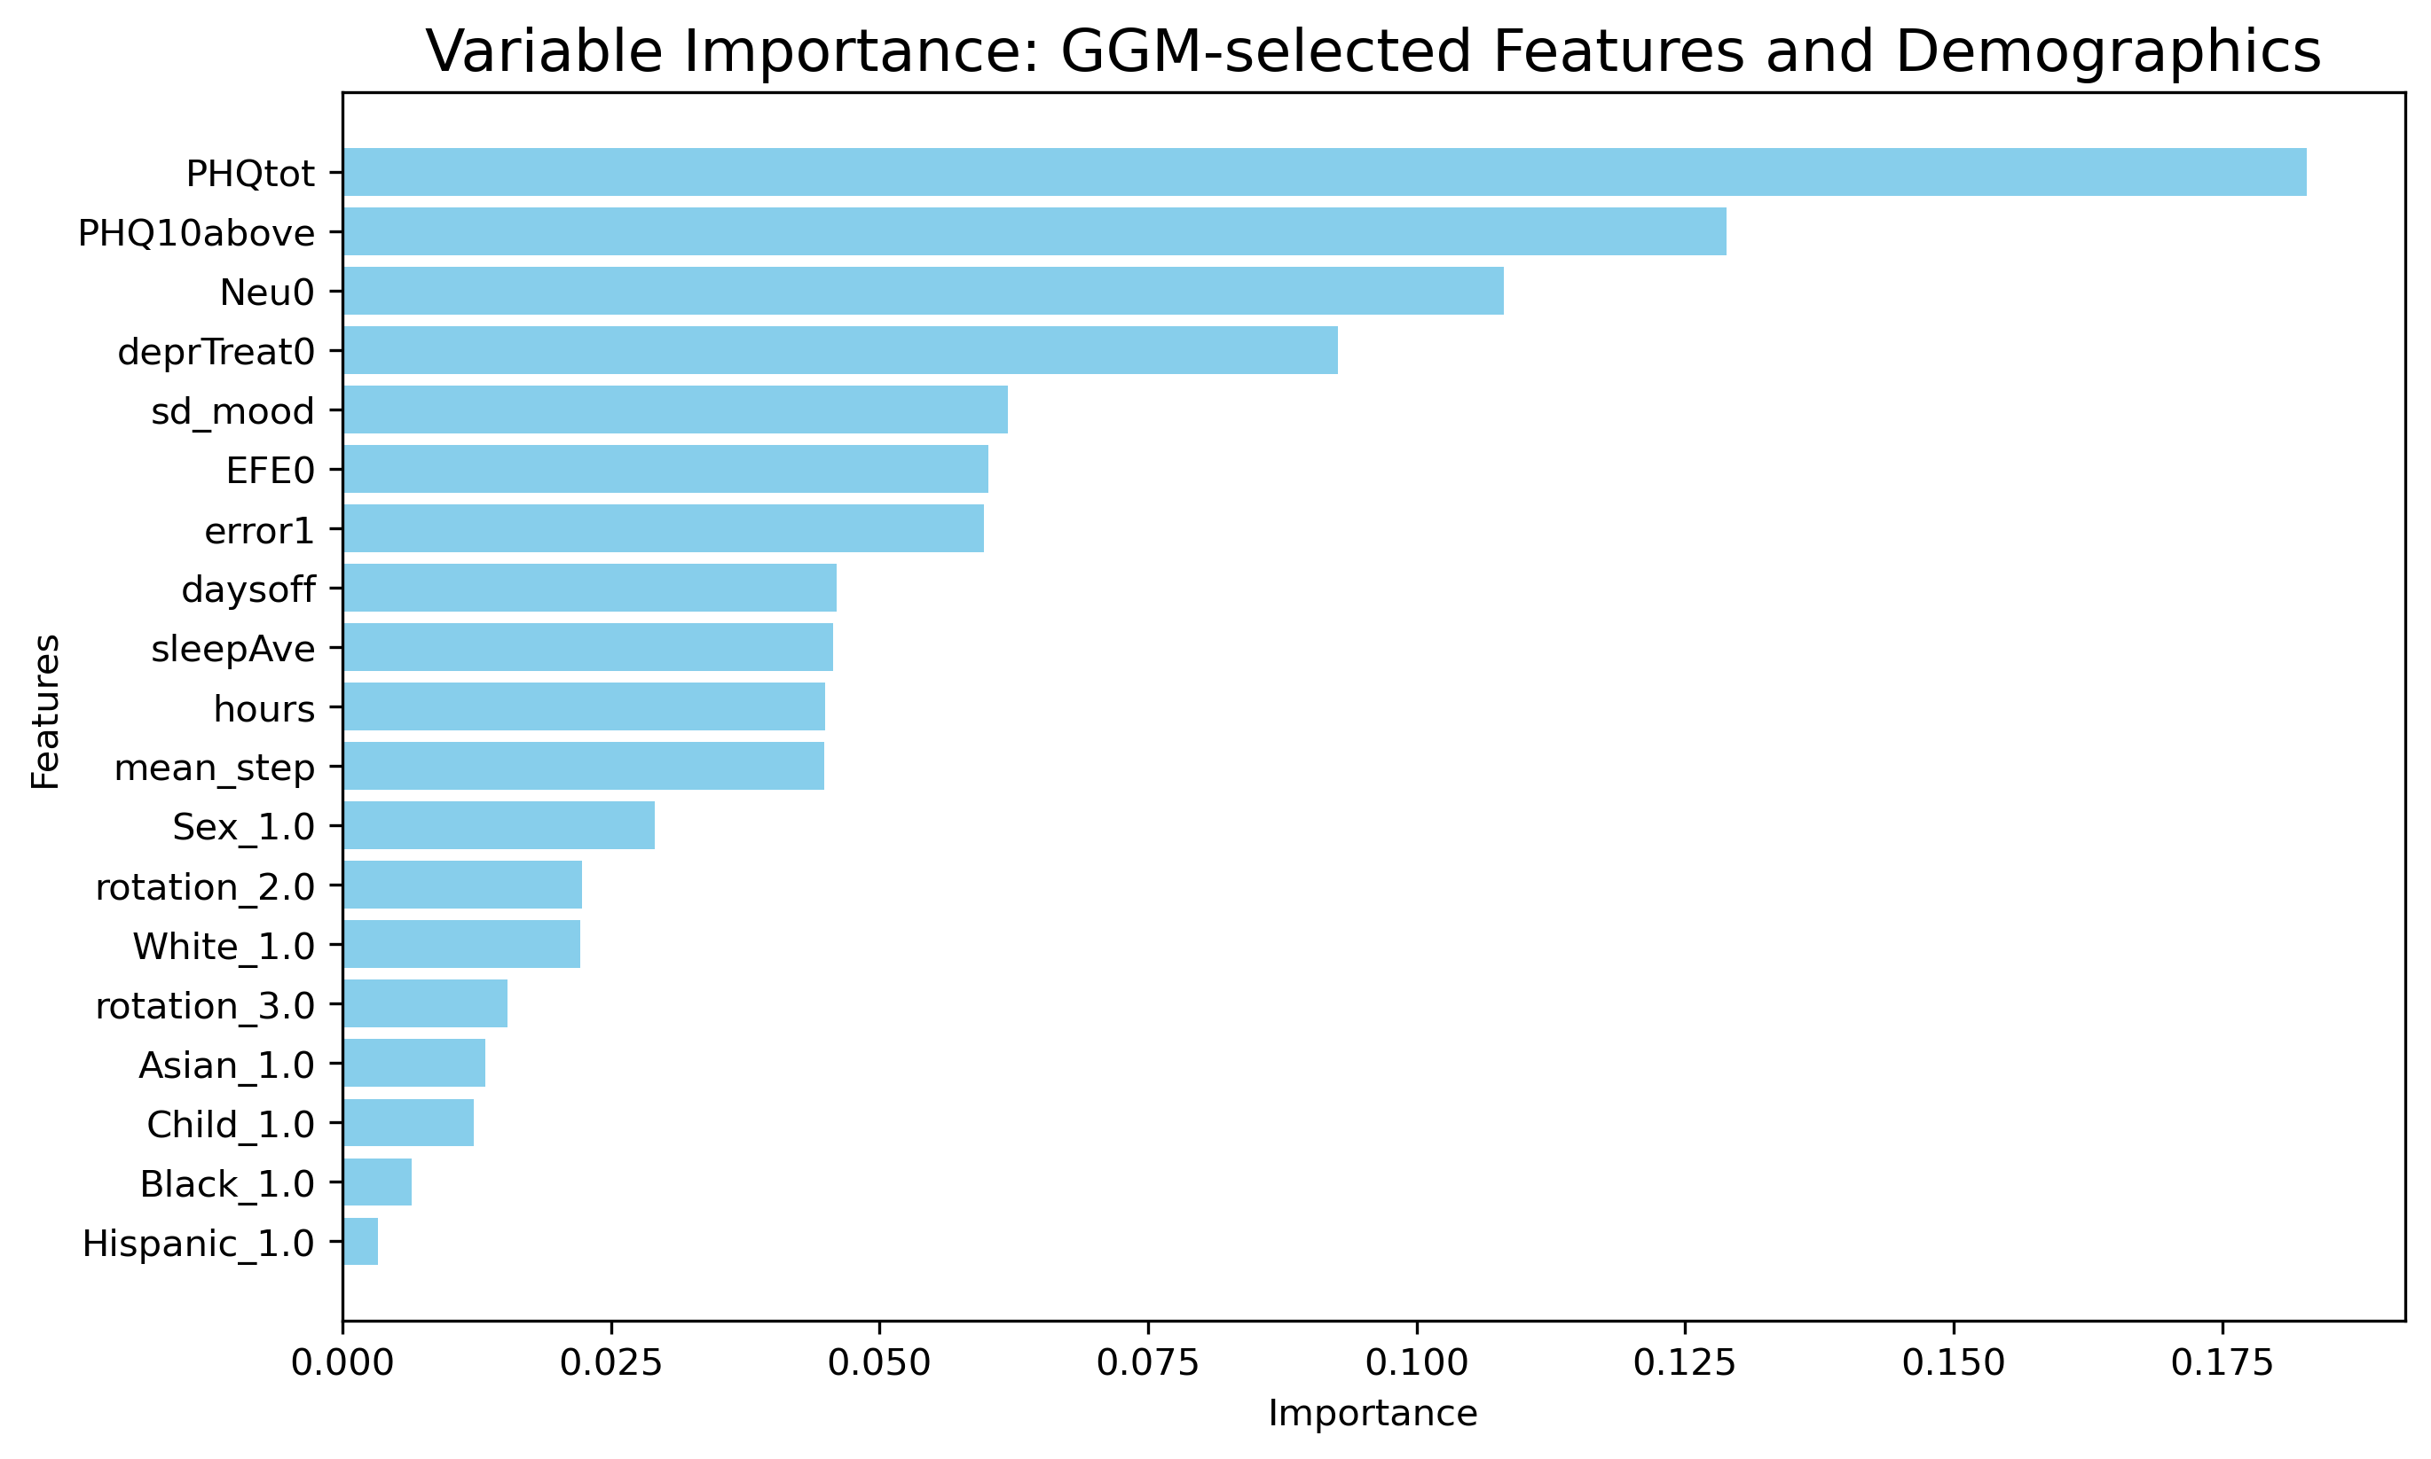
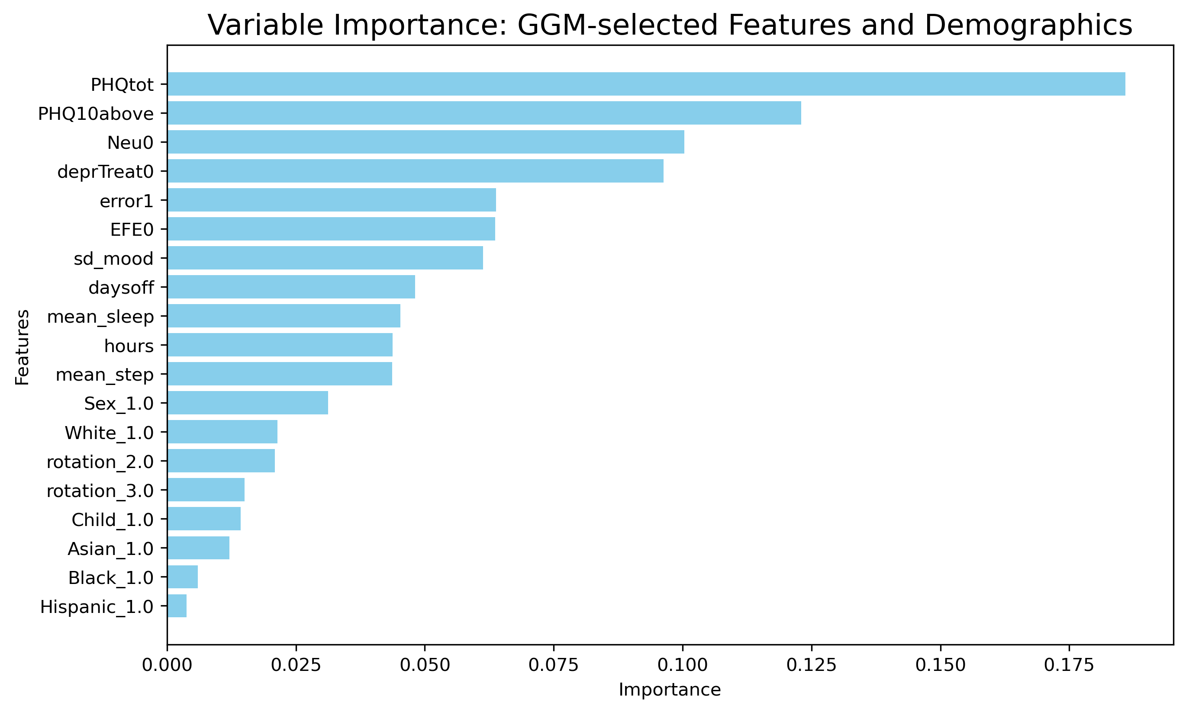
Variable Importance: GGM-Selected Features and Demographics Variables
Self-reported sleep duration (hours)
(b) Sensor-based sleep duration (hours)

Slide 5
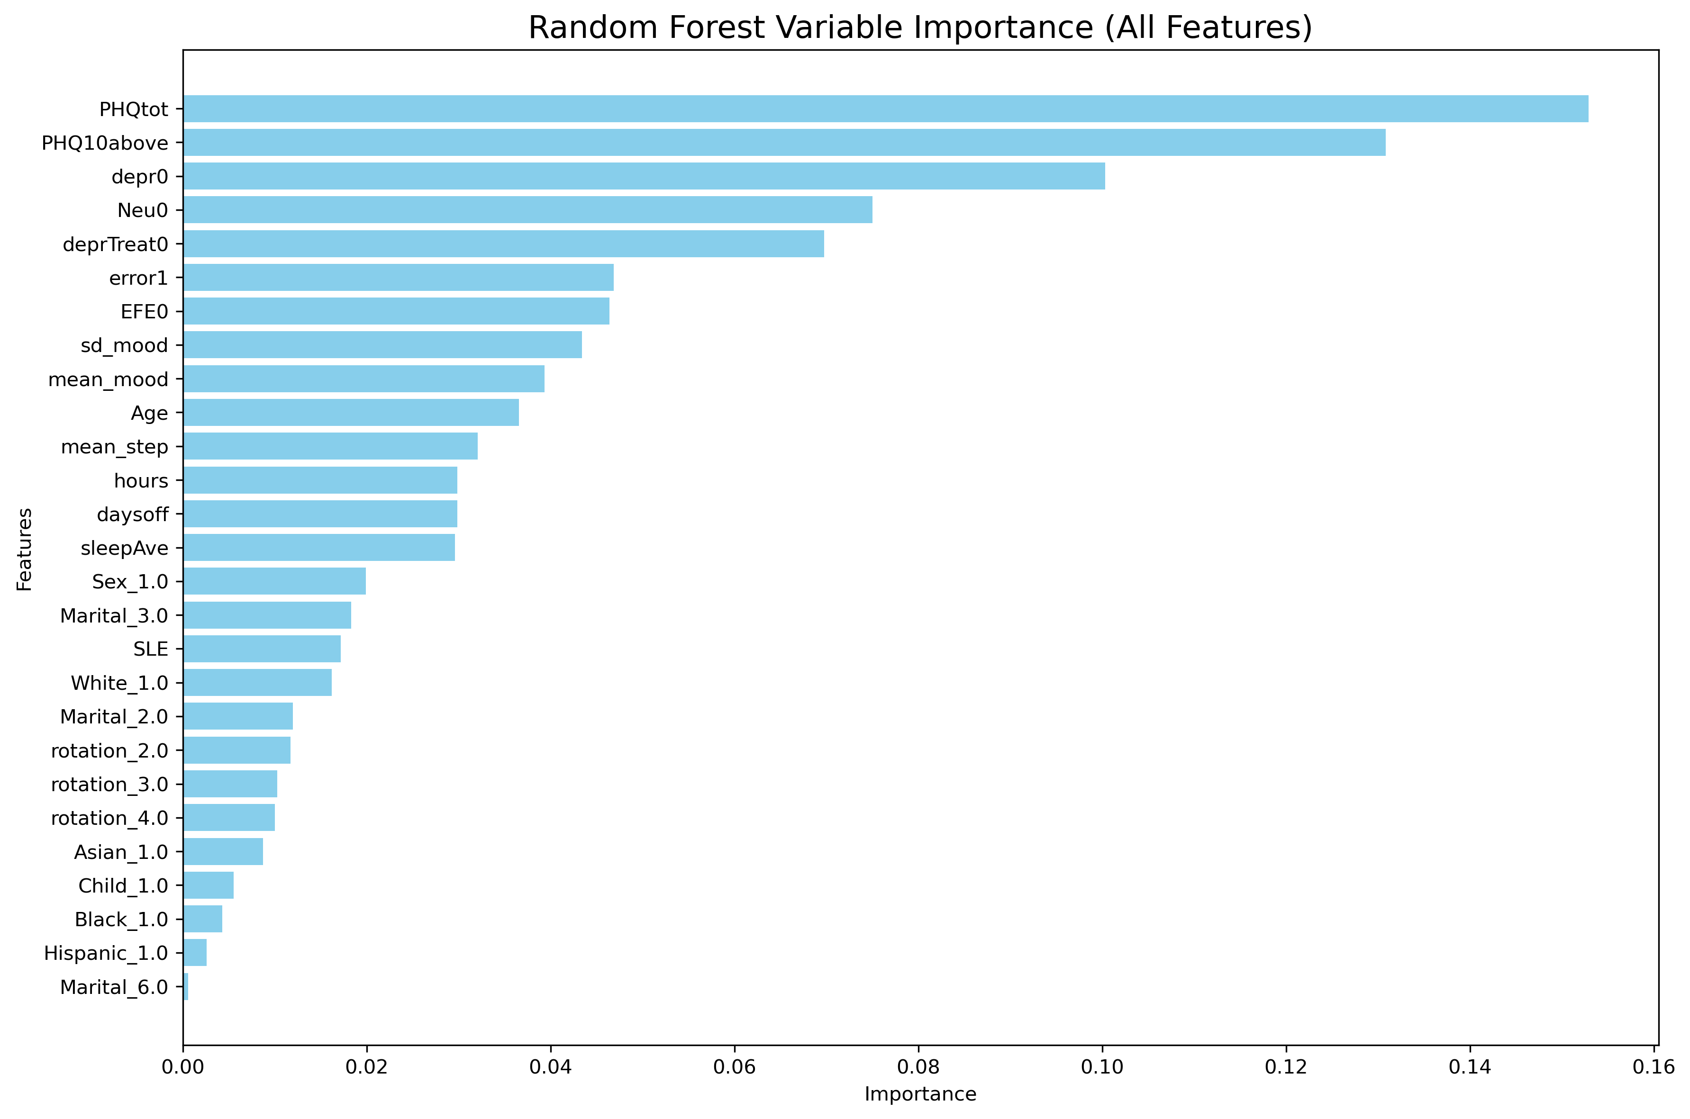
Variable Importance: RF-only, All Features

